Slide 1


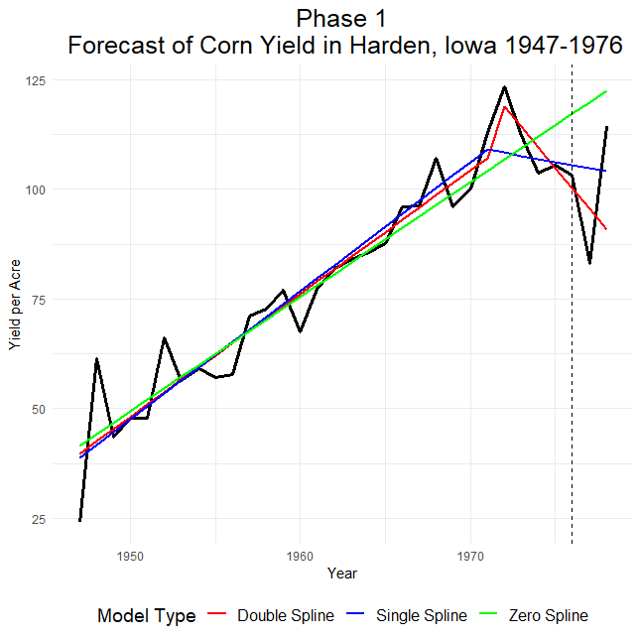
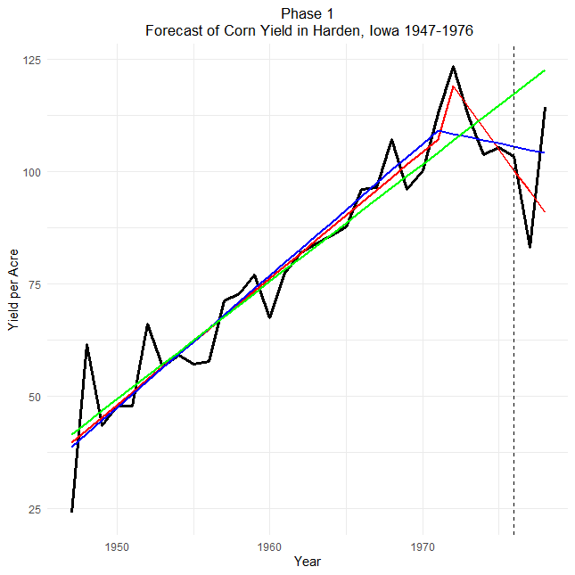
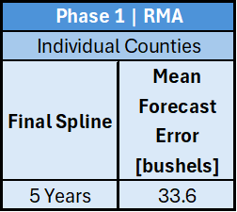
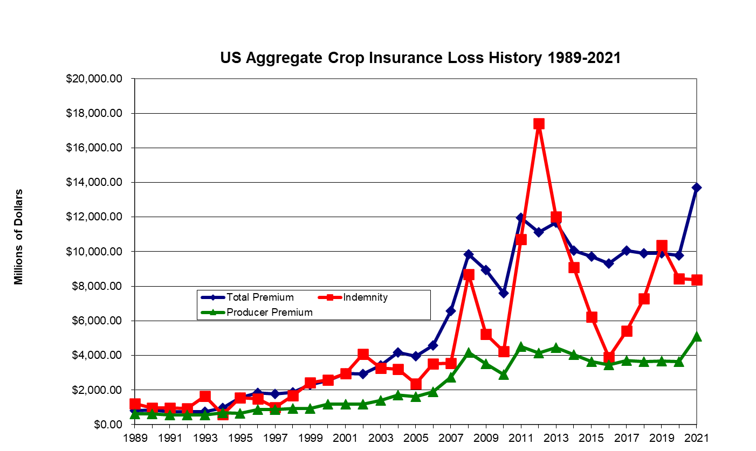
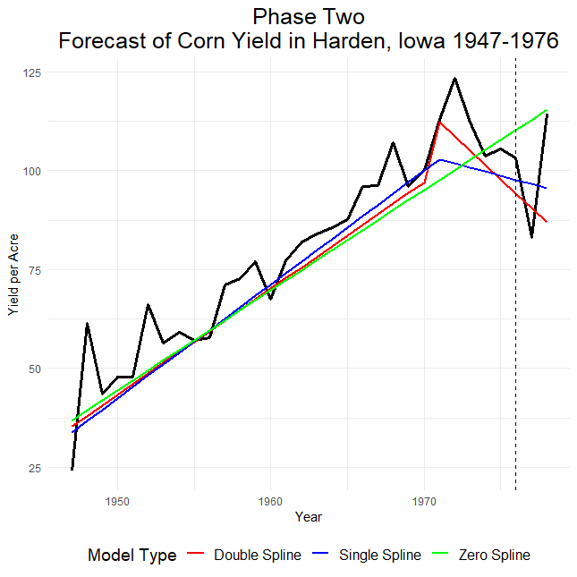
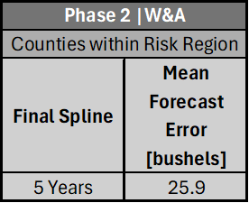
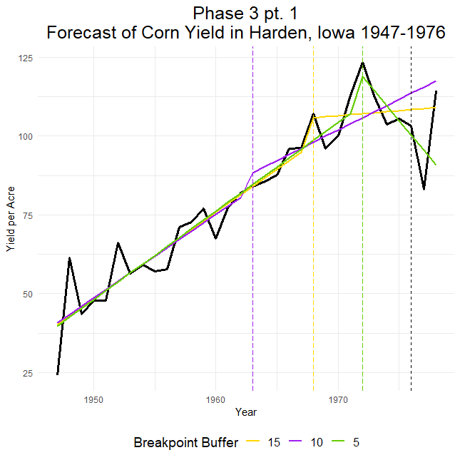
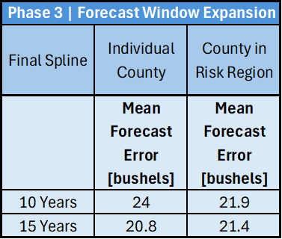
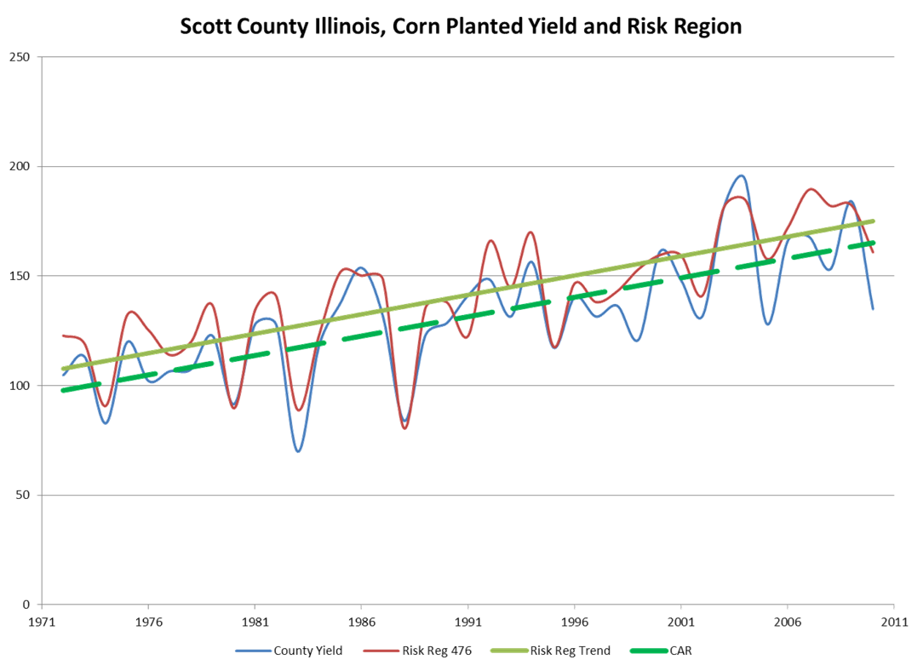
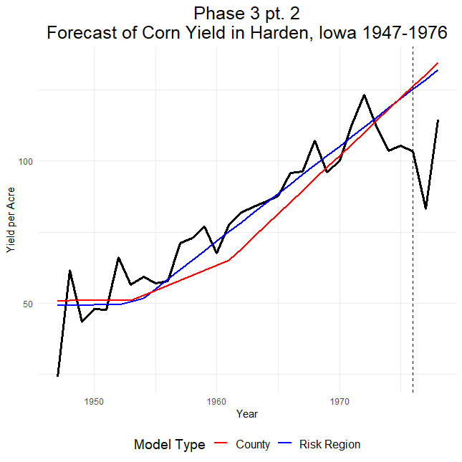
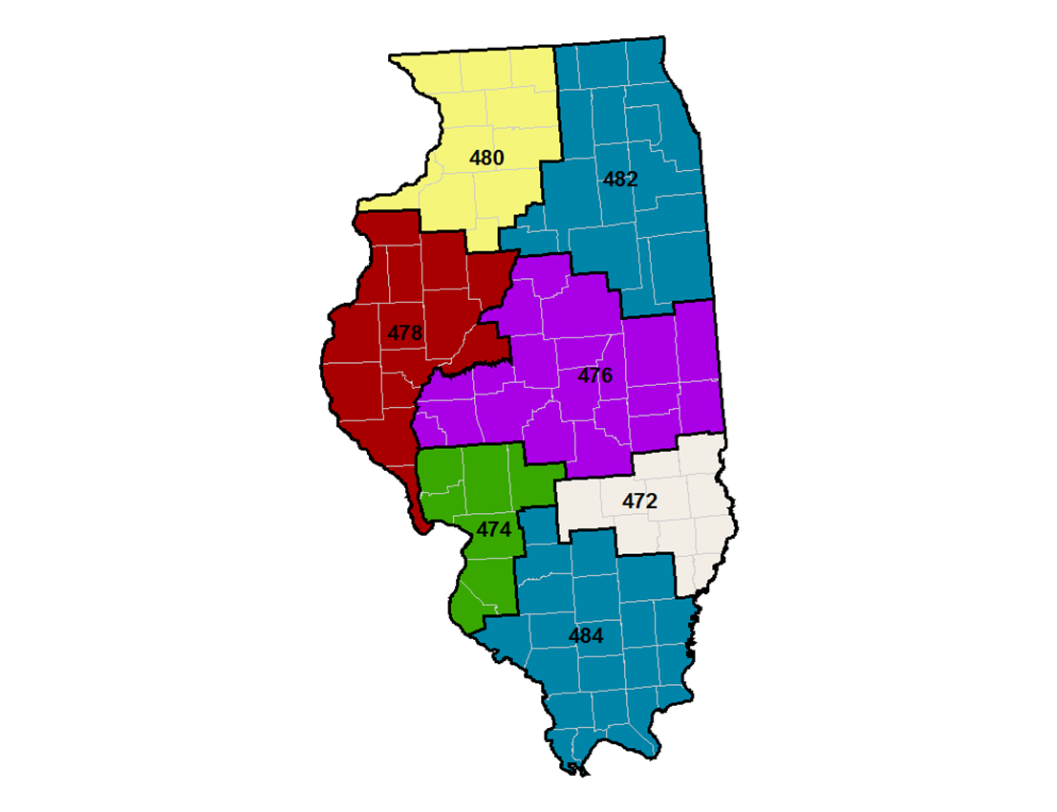
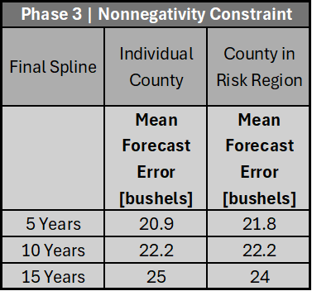
Harvesting Certainty: Innovation in Agricultural Yield Forecasting
Tommy Mellott | Hans Petersen | Merlin McKean | Max Taylor
Montana State University | Watts and Associates - Agricultural Risk Management
ABSTRACT
RESULTS
FORECASTING METHODOLOGY
Crop insurance mitigates risks for agricultural producers by providing protection in the event of adverse growing conditions. This insurance product is contingent upon the accuracy of crop yield forecasting. Inaccuracies can lead to unexpected financial burdens for producers, insurance companies, or the government, ultimately affecting consumers in the following ways:
Inaccurate Forecasts → 1) Higher Taxes
2) Higher Food Prices
3) Decreased Quality of Food
4) Disincentivized Farmers
Considering contemporary methods, researching novel methods, and considering underlying economic assumptions, the team formulated a forecasting model that historically outperformed models used today.
Phase 1| Individual Counties
Conducted Ordinary Least Squared (OLS) regression and piecewise single/double spline linear regression on yield by year
Each spline restricted from occurring in first or final 5 years
Best of the three models was selected according to minimum Akaike Information Criterion (AIC)
Phase 2| Counties within Risk Region
Conducted the same three regressions under same restrictions on each risk region and selected best model according to minimum AIC
Vertically shifted each county within risk region by the mean yield difference from risk region over the 30-year window
Phase 3
Part I | Forecast Window Expansion
Replicate Phase 1 and Phase 2 methodologies, but constrain the final spline from occurring within the final 5, 10, and 15 years
Part II | Nonnegativity Constraint
Replicate Phase 1 and Phase 2 methodologies, but constrain the slope after the final spline from being negative
Comparison:
Models are extrapolated 2 years ahead for out-of-sample backtesting
Calculated the Root Mean Squared Forecast Error (RMSFE) for all forecasts
CONCLUSION
Figure 1: Aggregated Crop Insurance Loss History from 1989-2021.
Part I | Forecast Window Extension
Piecewise linear regression models often overfit in-sample data, missing the underlying trend of the data
Substantial out-of-sample forecasting inaccuracies occur when final spline is close to forecasting period
Forecast error decreased as forecast window was lengthened from 5 to 10 to 15 years
Part II | Non-negativity Constraint
Inevitable advancements in agricultural technology ensure consistent or increased production over time, all else equal
Constraining a non-negative slope into forecasting periods accommodate this expectation
The mean forecast error of individual counties and counties within risk regions improved with the non negativity constraint
These significant improvements, if viable across other counties and crops, could signify room for innovation in the crop insurance space.
OBJECTIVES
Recreate the forecasting technique utilized by the Risk Management Agency (RMA) and conduct out-of-sample backtesting to evaluate.
Replicate the forecasting approach devised by Watts & Associates and subsequently assess its accuracy through out-of-sample backtesting.
Apply insights gained from prior methods to develop a novel forecasting methodology aimed at surpassing the forecast accuracy of both the RMA and Watts & Associates methods.
CONTACT INFORMATION
Tommy Mellott - tommy.mellott2@gmail.comMerlin McKean merlinmckean@gmail.com
Hans Petersen - hans.c.petersen2001@gmail.com Max Taylor - max.h.t@live.com
ACKNOWLEDGEMENTS
ACKNOWLEDGEMENTS
Watts and Associates
John Kuhling
Montana State University
Dr. Andrew Hill | Dr. Joseph Atwood | Dr. Faraz Dadgostari
Figure 2: Graph of a vertical adjustment to individual counties within a Risk Region in Phase 2.
Figure 3: Risk Regions within Illinois
Mountains & Minds

